Slide 1
Cavalry Crossing a Ford
Walt Whitman,
Leaves of Grass

Slide 2
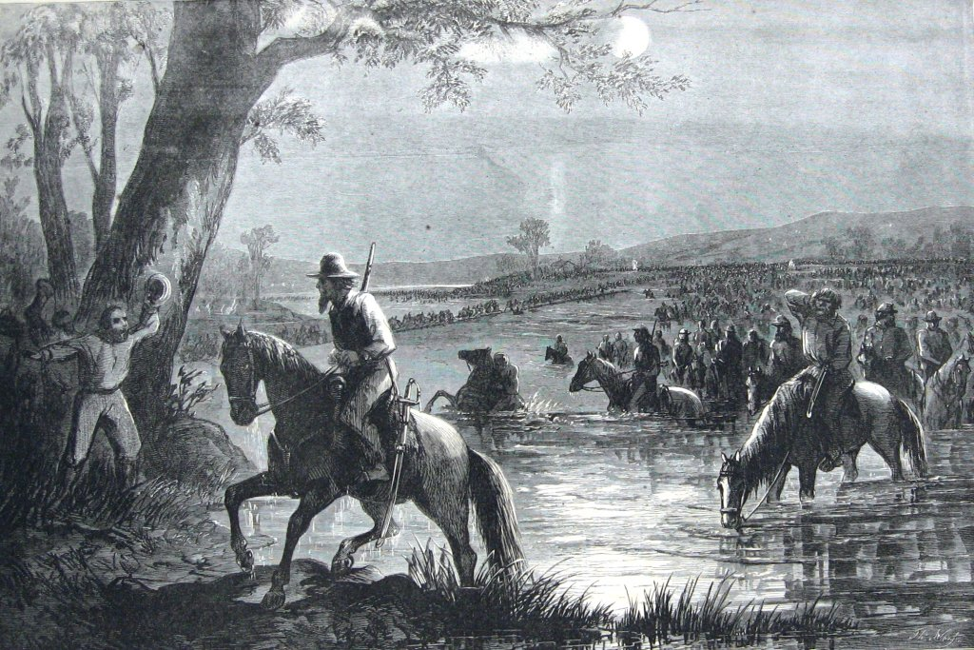
A line in long array, where they wind betwixt green islands; They take a serpentine course—their arms flash in the sun— Hark to the musical clank;

Slide 3
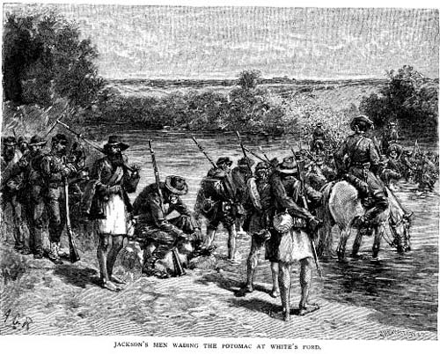
Behold the silvery river—in it the splashing horses, loitering, stop to drink; Behold the brown-faced men—each group, each person, a picture—the negligent rest on the saddles;
Notes:
Jackson’s men wading the Potomac at White’s Ford

Slide 4
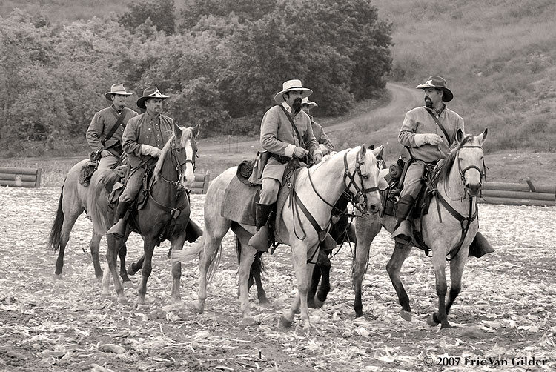
Some emerge on the opposite bank—others are just entering the ford—while,
Notes:
Jackson’s men wading the Potomac at White’s Ford

Slide 5
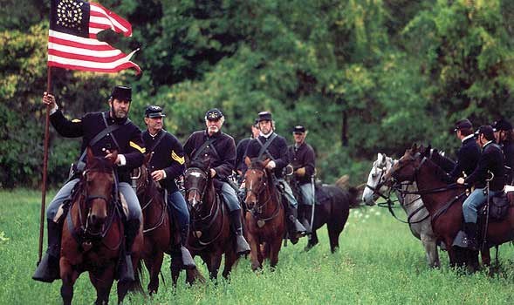
Scarlet, and blue, and snowy white, The guidon flags flutter gaily in the wind.
Notes:
Jackson’s men wading the Potomac at White’s Ford

Slide 6
Night March
Herman Melville

Slide 7
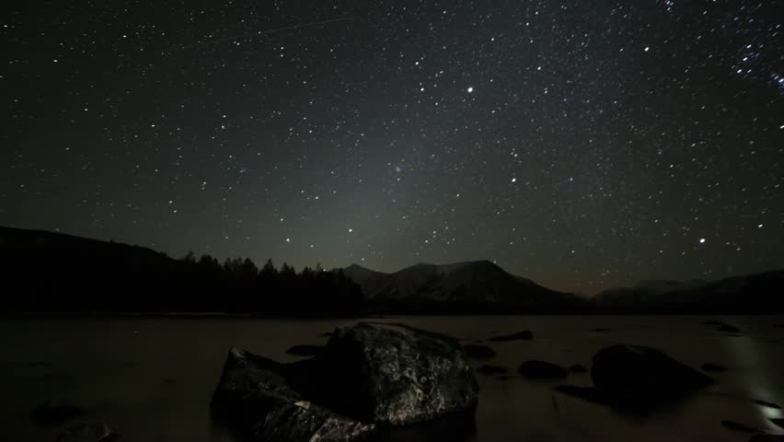
With banners furled and clarions mute,
An army passes in the night;

Slide 8
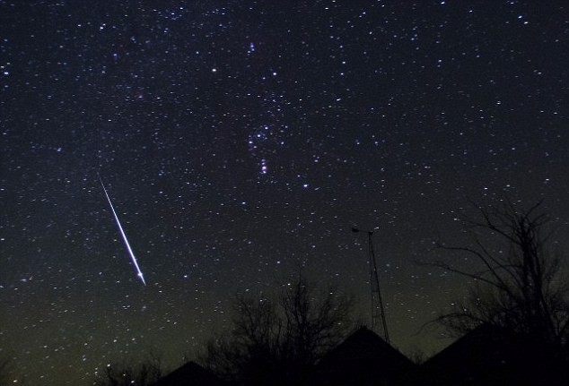
And beaming spears and helms salute
The dark with bright.

Slide 9
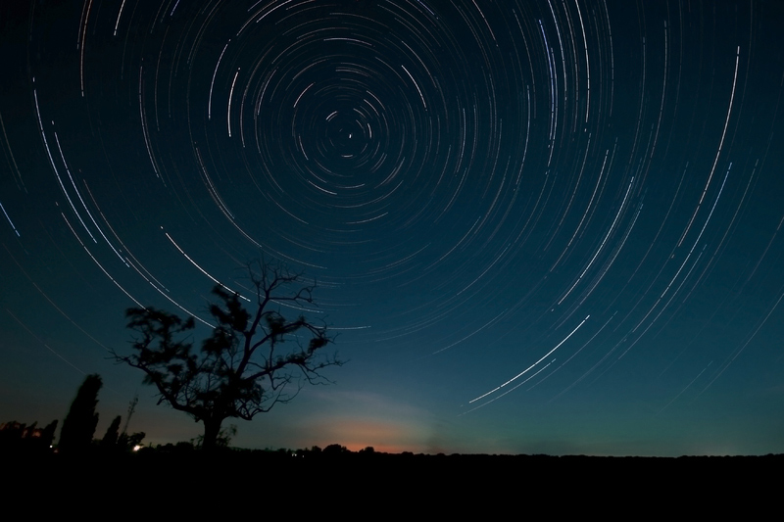
In silence deep the legions stream,
With open ranks, in order true;

Slide 10
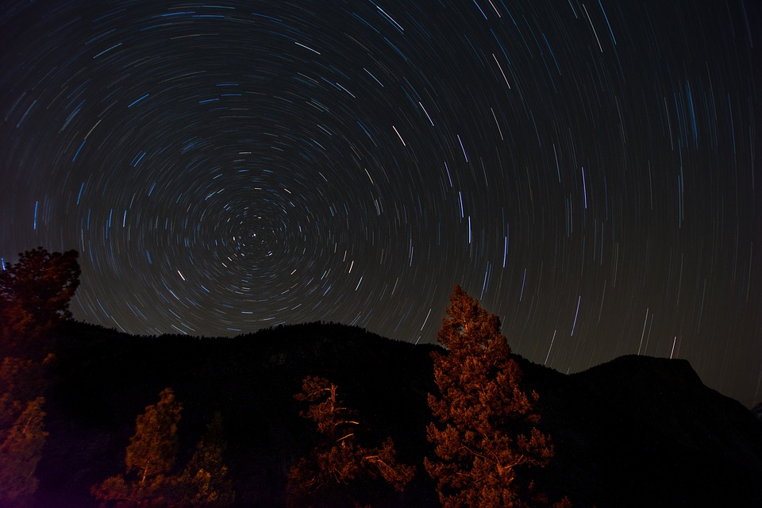
Over boundless plains they stream and gleam
No chief in view!

Slide 11
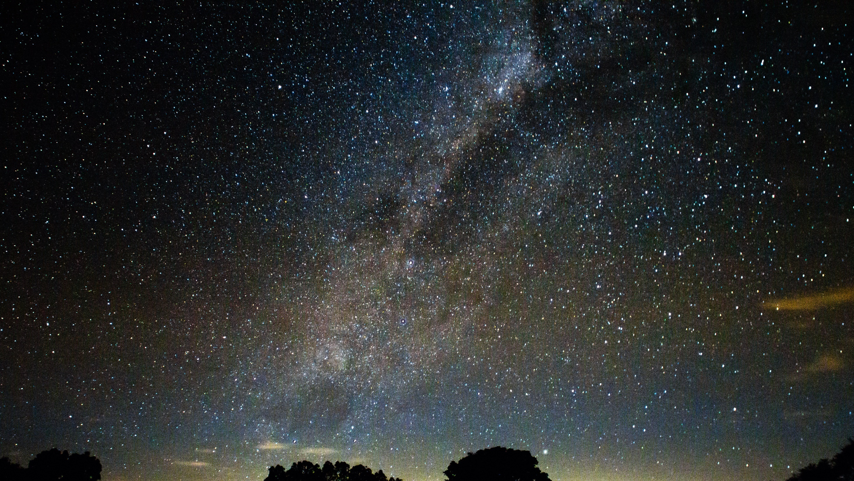
Afar, in twinkling distance lost,
(So legends tell) he lonely wends

Slide 12
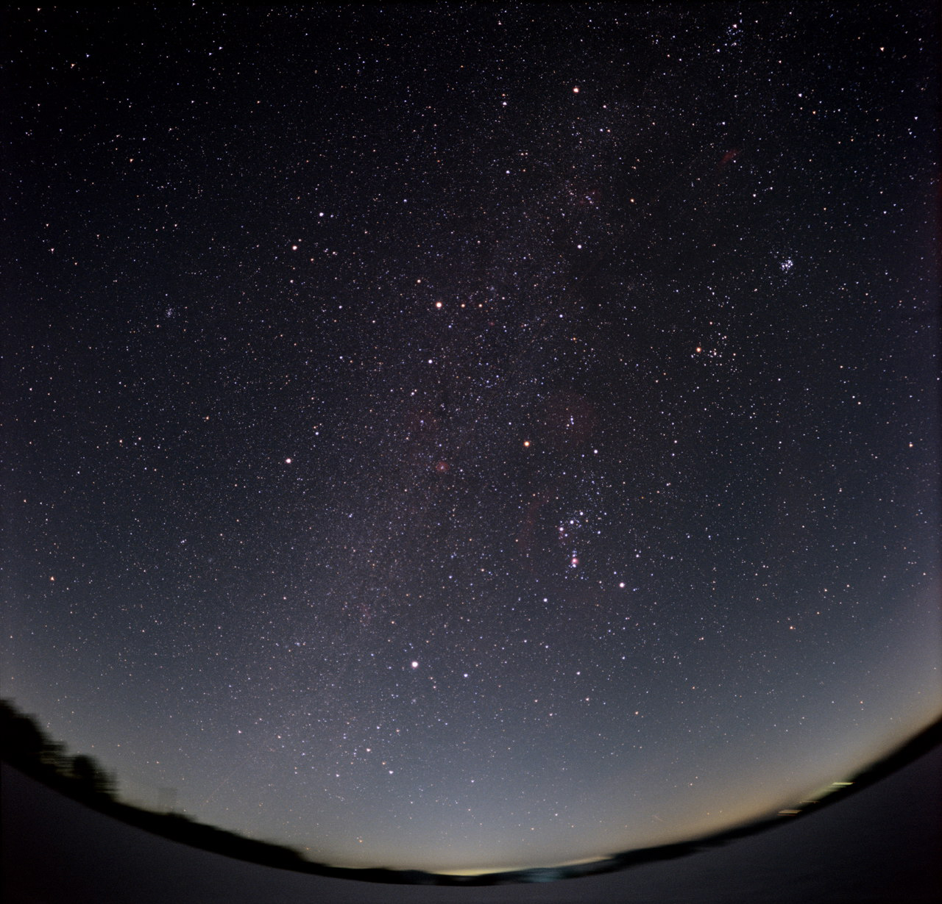
And back through all that shining host
His mandate sends.

